Slide 1
Decoding the Quantum Realm: From Theory to Technology
QUANTUM GRADIENT THEME

Slide 2
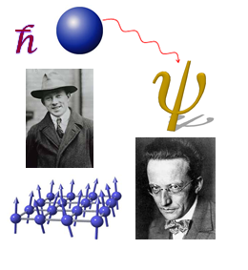
Entering the Quantum World
A journey into the bizarre and groundbreaking science that governs the universe at its smallest scales.

Slide 3
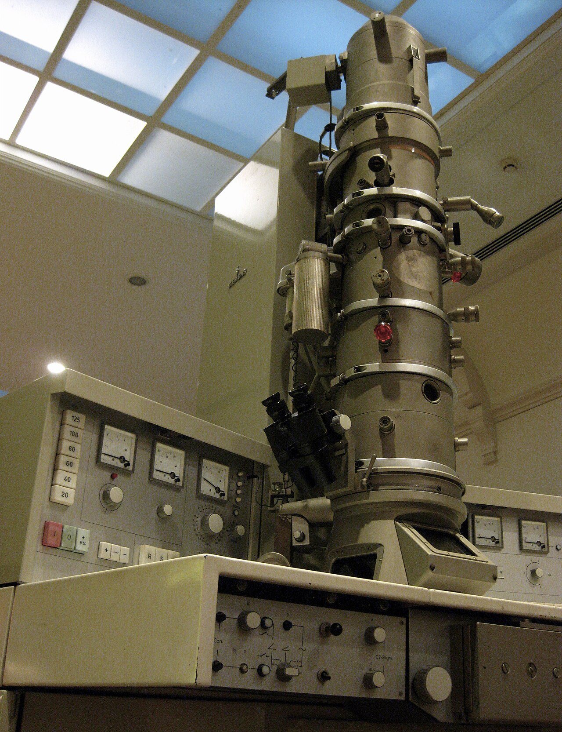
Fundamental Concepts of Quantum Mechanics
Quantum mechanics diverges dramatically from classical physics by asserting that certain properties of a bound system, like energy and momentum, are quantized, existing only in discrete values.
This quantization means that energy levels are not continuous but rather occur in specific, defined steps similar to climbing a staircase rather than a ramp.
Wave-particle duality challenges our intuitive understanding, suggesting that particles, like electrons, can exhibit both wave-like and particle-like behaviors depending on how they are observed.
Superposition describes the ability of a quantum system to exist in multiple states simultaneously until measured, at which point it collapses into a single, definite state.
Quantum entanglement allows two or more particles to become linked in such a way that they share the same fate, no matter how far apart they are, enabling instantaneous correlation.
2

Slide 4
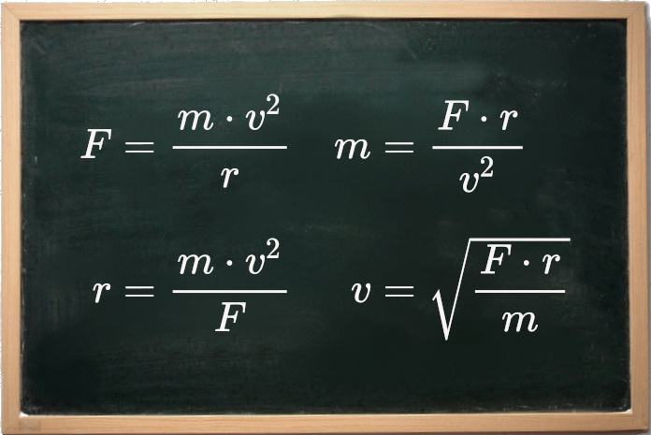
Core Equations and Principles
Unveiling the mathematical framework and guiding principles that underpin quantum phenomena.

Slide 5
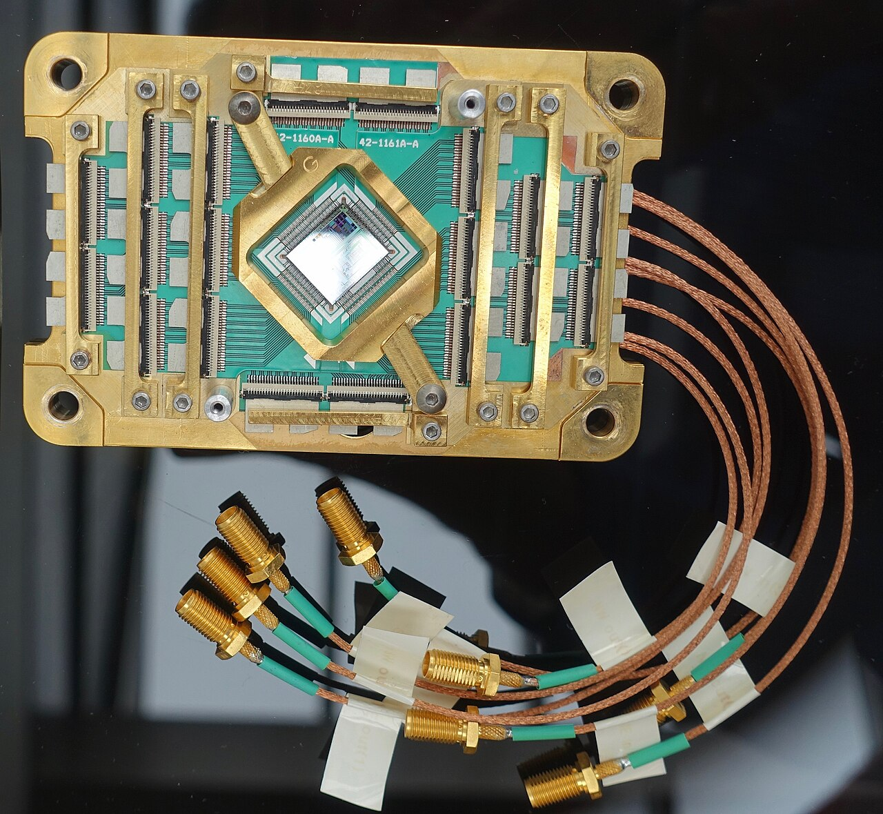
The Schrödinger Equation: A Quantum Cornerstone
The time-dependent Schrödinger equation is pivotal in quantum mechanics, illustrating how the quantum state of a physical system evolves over time by describing the wave function.
Solutions to the Schrödinger equation provide insight into the allowed energy levels and probabilities of finding a particle in a particular state, revealing the underlying quantum dynamics.
The equation’s solutions are complex-valued functions, reflecting the probabilistic nature of quantum mechanics and indicating that the wave function itself is not directly observable.
Time-independent versions simplify analysis for systems where the potential energy doesn't change with time, aiding in understanding stationary states like atomic electron configurations.
Advanced numerical methods are often required to solve the Schrödinger equation for complex systems, enabling researchers to simulate and predict quantum behaviors and system properties.
4

Slide 6
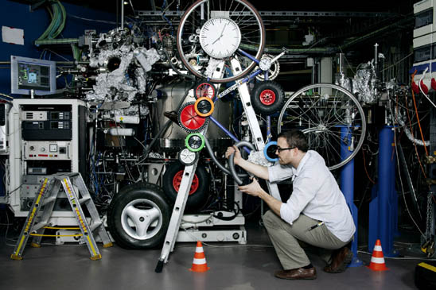
Uncertainty and Measurement Paradoxes
The Heisenberg uncertainty principle establishes a fundamental limit on the precision with which certain pairs of physical properties of a particle, such as position and momentum, can be known simultaneously.
This principle isn't just a limitation of measurement technology; it's an inherent property of quantum systems, meaning the more accurately one property is known, the less accurately the other can be.
The act of measurement profoundly influences quantum systems, causing them to collapse from a superposition of states into a single, definite state, directly affecting the observed reality.
Quantum tunneling describes the probability of a particle passing through a potential barrier even when it doesn't have sufficient energy, enabling processes such as nuclear fusion in stars.
Bell's theorem and experimental tests confirm that quantum mechanics violates local realism, suggesting that entangled particles are correlated in ways that cannot be explained by classical physics.
5

Slide 7
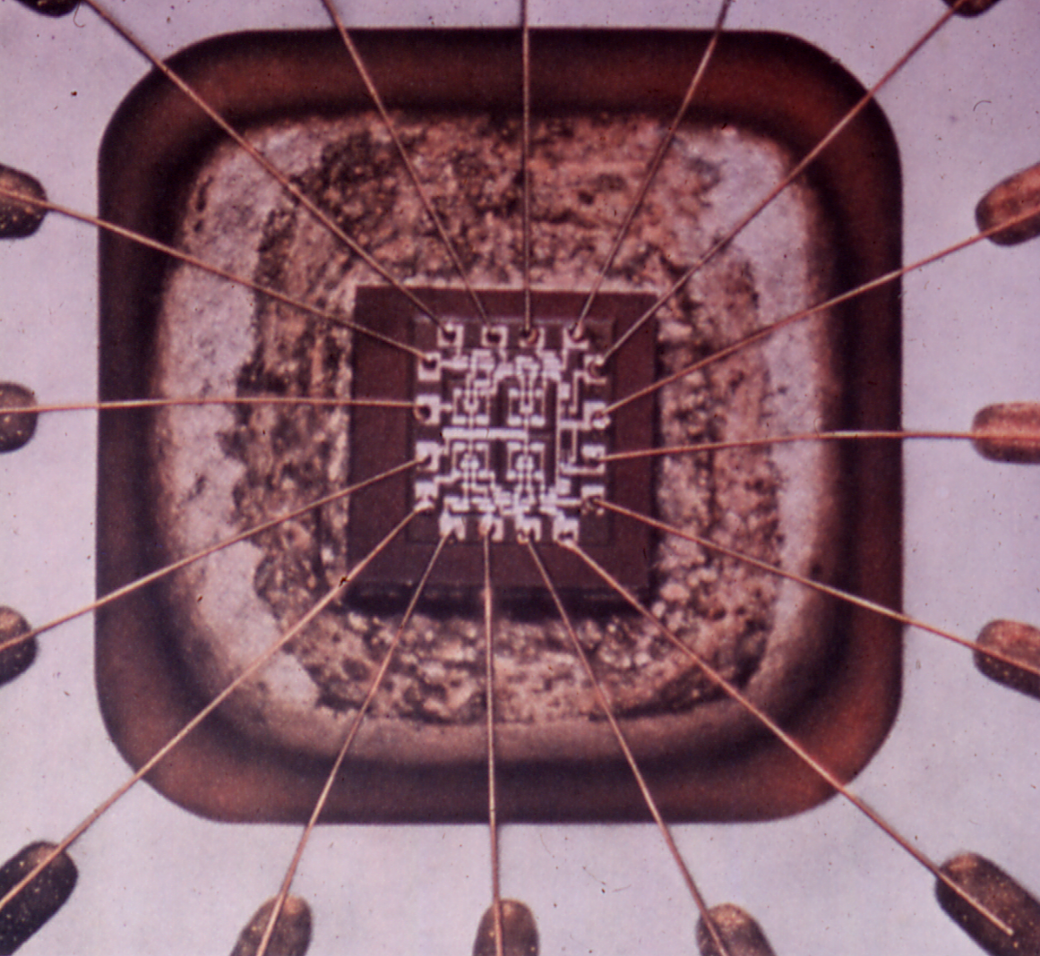
Real-World Quantum Applications
The transformative impact of quantum mechanics on modern technology and future innovations.

Slide 8
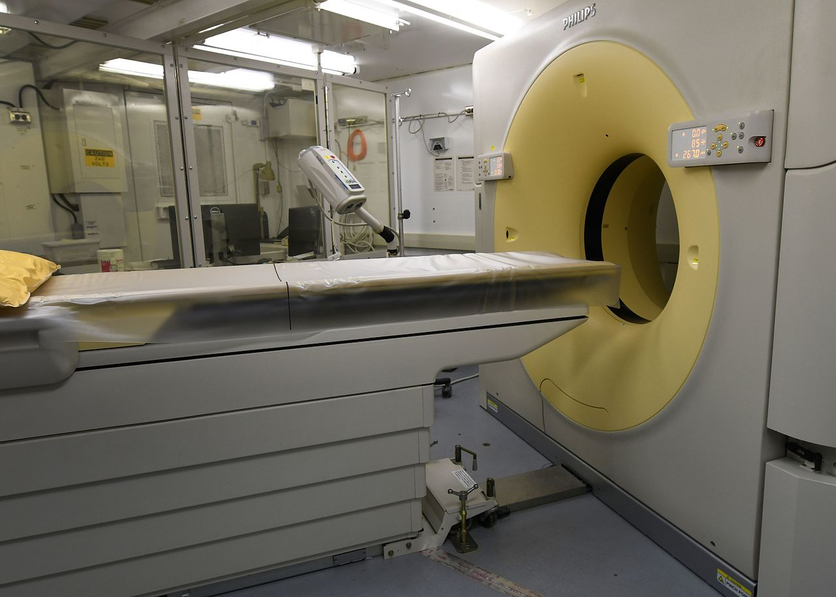
Applications of Quantum Mechanics Across Industries
Quantum mechanics is indispensable for grasping the behavior of semiconductors in transistors and integrated circuits, forming the foundation of modern computing technology.
Laser technology, crucial in devices from barcode scanners to medical instruments, relies heavily on quantum principles to generate coherent light beams with precise properties.
Magnetic Resonance Imaging (MRI) uses quantum mechanical properties of atomic nuclei to create detailed images of the human body, transforming diagnostics.
Advances in quantum computing promise to solve complex problems beyond the reach of classical computers, revolutionizing fields like cryptography and materials science.
Quantum cryptography offers secure communication methods by leveraging the principles of quantum mechanics to detect eavesdropping attempts, ensuring data privacy and integrity.
7

Slide 9

Quantum Tech: A Rapidly Expanding Market
35%
$86B
Projected Annual Growth Rate
Total Market Size by 2040
7x
6000+
Increase in Quantum Computing Investment
Quantum-Related Patents Filed
8

Slide 10

“
Anyone who is not shocked by quantum theory has not understood it.
-- Niels Bohr
9

Slide 11
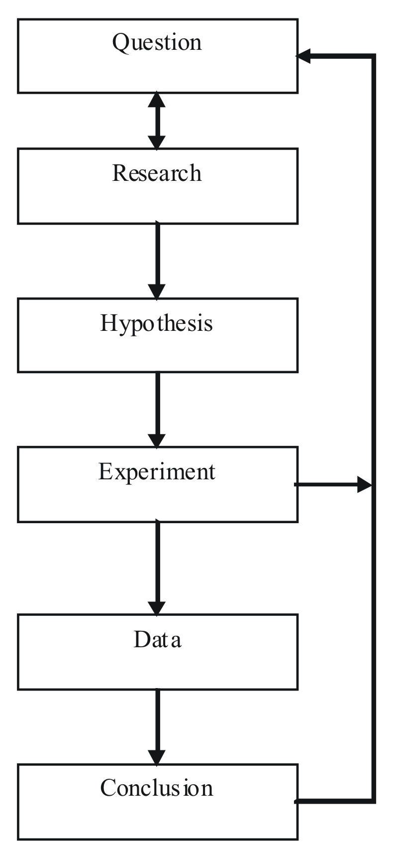
Quantum Revolution History
1900
1935
2010s-Present
Max Planck introduces the concept of quantized energy, solving the black-body radiation problem and laying the foundation for quantum theory.
Einstein, Podolsky, and Rosen (EPR) introduce the EPR paradox, questioning the completeness of quantum mechanics and sparking debates about entanglement.
Rapid advancement in quantum computing and quantum cryptography, with ongoing efforts to build scalable quantum computers and secure communication networks.
Erwin Schrödinger publishes the Schrödinger equation, a cornerstone of quantum mechanics, describing how quantum systems evolve over time.
Development of semiconductor technology and lasers, leveraging quantum mechanics for practical applications in electronics and photonics.
1926
Late 20th Century
10

